Slide 1
The history of Tor browser
By: Colin Quinn

Slide 2

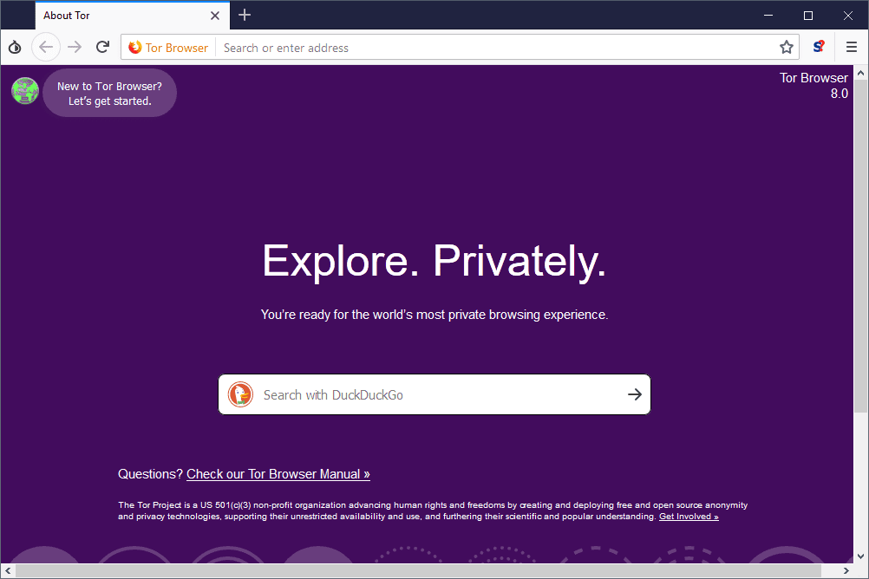
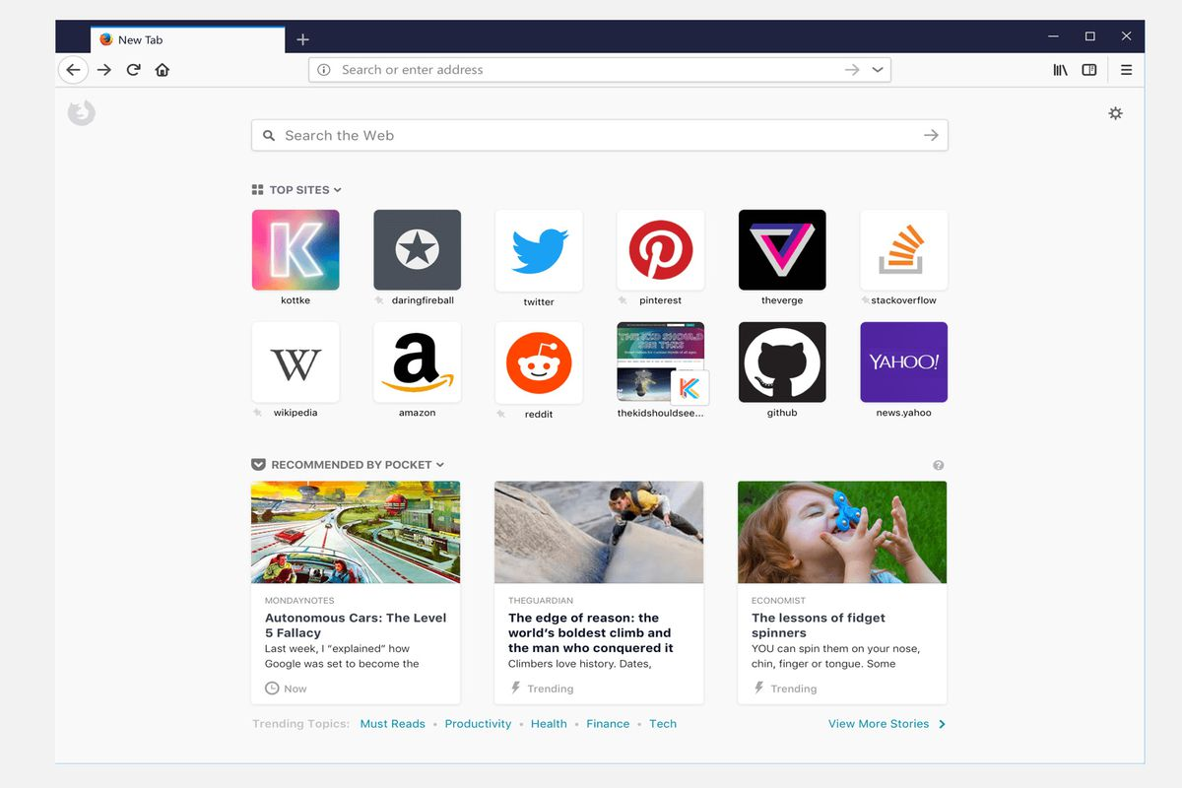
What is the tor browser?
Alpha release in 2002, first public release on August 13, 2004
Tor, meaning The Onion Router
The browser is essentially Firefox with some additions for anonymity

Slide 3
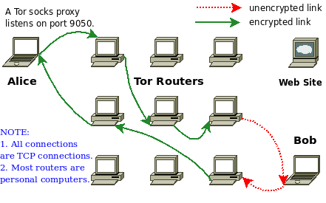

How does tor work?
Utilizes its own network
A packet is encrypted only showing the current location and the desired location
As the packet goes through the network, each relay encrypts the previous stop
Layers of encryption hide the main information within the packet

Slide 4
Who made Tor?
Development started during the mid 1990’s in the United States Naval Research Lab by Michael Reed and Paul Syverson
In 1997, the project transferred to Defense Advanced Research Projects Agency (DARPA)
In 2006, The Tor Project, a research-based non-profit is founded by Roger Dingledine and Nick Mathewson
Entire board of directors for The Tor Project resign in July 2016 and are replaced

Slide 5



Who uses tor?
Government Agencies
Whistleblowers and many News websites
Hacktivist groups
Black Market transactions and Silk Road

Slide 6

Tor’s connection to silk road
First bitcoin transaction in 2009 between creator Satoshi Nakamoto and Hal Finney, one of the first contributors to the project
Anonymous transactions enabled through bitcoin and Tor
Silk Road was accessible through Tor’s hidden service feature
https://darknetdiaries.com/episode/24/ Operation Bayonet

Slide 7
Is tor Truly anonymous?
Short answer: no
Long answer: it can be close if configured and used properly

Slide 8

The end

